Slide 1
Coding convention Writing clean code (part 1)
Doan Trung Tung, PhD

Slide 2
Coding convention

Slide 3
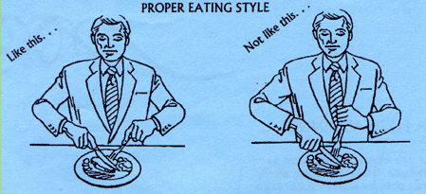
What is coding convention?
Every language has syntax that we MUST follow
Every language has convention that we don’t have to follow but we SHOULD follow
Coding convention: rules of writing code that we should follow

Slide 4
Why do we have to follow convention?
Because you don’t write code for yourself!
Others want to understand what you write!
What are the benefits of coding convention?
Easy to read and understand
Avoid ambiguous source code
Reduce error
Can reading code be likes reading story?
What you read is what I meant!
How? I mean really how?
Notes:
Giống chị em mặc đồ cho người khác ngắm
Một số người thích ngắm mình trong gương – selfie :p

Slide 5
What convention to follow?
Language convention
C / C++: get_area / getArea
Java: getArea
C#: GetArea
Python: get_area
etc.
Company convention
Team convention
Project convention
Java
Common
Convention
C++
Google’s style

Slide 6
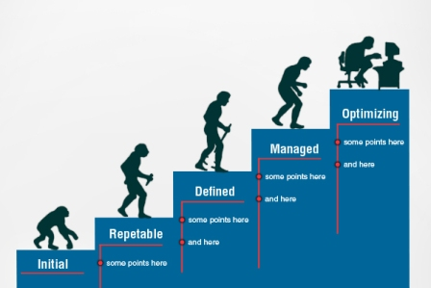
How strictly we have to follow convention?

Slide 7
Goal: Self-Documenting Code
Self-documenting Code can explain itself without need for external documentation, like flowcharts, UML diagrams, process-flow diagrams, etc.
Doesn’t imply we don’t like/use those documents!
Coding conventions target:
How you write statements in the language, organize them into “modules,” format them in the source files
Module: Class, subclass, interface.
How you create names
How you write comments

Slide 8
Coding Conventions Apply To…
Names (chosen by programmer)
Comments, 3 types:
File headers (class headers)
Function headers
Explanations of variables and statements
Statements
Organization: files, “modules”, nesting
Format: spacing and alignment

Slide 9
1. Naming convention
Be consistent!
Names representing types must be in mixed case starting with upper case.
Line, SavingsAccount
Variable names must be in mixed case starting with lower case.
line, savingsAccount
Named constants (including enumeration values) must be all uppercase using underscore to separate words.
MAX_ITERATIONS, COLOR_RED, PI
Names representing methods or functions must be verbs and written in mixed case starting with lower case.
getName(), computeTotalWidth()

Slide 10
1. Naming convention
Variables with a large scope should have long names, variables with a small scope can have short names
Loop variable: i, j, k, iter, n
count, tmp, val, max
nEmployees, maxSalary, selectedIndex
Variables should be declared at first use
The name of the object is implicit, and should be avoided in a method name.
line.getLength(); // NOT: line.getLineLength();

Slide 11
1. Naming convention
Plural form should be used on names representing a collection of objects.
The prefix n should be used for variables representing a number of objects.
The suffix No should be used for variables representing an entity number.
ArrayList<Point> points;
int values[];
nPoints, nLines
tableNo, employeeNo

Slide 12
1. Naming convention
Use prefix is / has / can for functions return logical values
Complement names must be used for complement operations.
Functions should be named after what they return and procedures should be named after what they do..
bool hasLicense();
bool canEvaluate();
bool isSorted();
get/set, add/remove, create/destroy, start/stop, insert/delete
int getAge();
void printInfo();

Slide 13
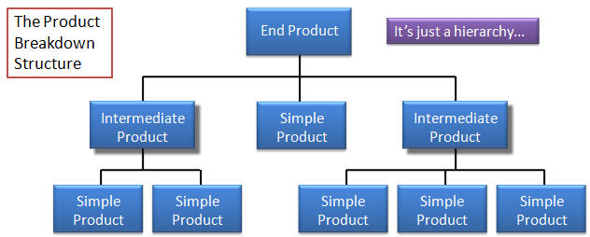
2. File name & content
One file for one class. Avoid implementing several classes in one file as much as possible
Group related classes into one folder
Group related folders into one folder
Organize folders as PBS (Product Breakdown Structure)
Notes:
Khi nào thì viết 1 lớp trong 1 lớp khác?

Slide 14
3. Statement convention
Type conversions must always be done explicitly. Never rely on implicit type conversion.
Complex conditional expressions should be avoided.
floatValue = (float) intValue; // NOT: floatValue = intValue;
bool isFinished = (elementNo < 0) || (elementNo > maxElement); bool isRepeatedEntry = elementNo == lastElement;
if (isFinished || isRepeatedEntry)
{
// statements
}
Notes:
Implicit conversions can hide type-mismatch bugs, where the destination type does not match the user's expectation, or the user is unaware that any conversion will take place.
Implicit conversions can make code harder to read, particularly in the presence of overloading, by making it less obvious what code is actually getting called.

Slide 15
3. Statement convention
Executable statements in conditionals should be avoided.
Floating point constants should always be written with decimal point and at least one decimal.
Employee emp = listEmployees.find(name);
if (emp != null)
{ : }
if ((emp = listEmployees.find(name)) != null)
{ : }
double total = 0.0; // NOT: double total = 0;
double speed = 3.0e8; // NOT: double speed = 3e8; double sum = (a + b) / 10.0; // Not 10

Slide 16
4. Layout
Makes lines at same level of nesting stand out.
if ( flag == 0 ) {
var1 = 0;
if ( var2 > level1 ) {
var2 = level1;
level1 = 0;
}
printf ( "%d/n", var2 );
}

Slide 17
4. Layout
White Space
a = (b + c) * d; // NOT: a=(b+c)*d
while (true) // NOT: while(true)
doSomething(a, b, c, d); // NOT: doSomething(a,b,c,d);
case 100 : // NOT: case 100:
for (i = 0; i < 10; i++) { // NOT: for(i=0;i<10;i++){

Slide 18
4. Layout
Logical units within a block should be separated by one blank line.
Matrix4x4 matrix = new Matrix4x4();
double cosAngle = Math.cos(angle);
double sinAngle = Math.sin(angle);
matrix.setElement(1, 1, cosAngle);
matrix.setElement(1, 2, sinAngle);
matrix.setElement(2, 1, -sinAngle);
matrix.setElement(2, 2, cosAngle);
multiply(matrix);

Slide 19
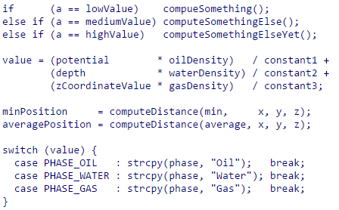
4. Layout
Use alignment wherever it enhances readability.

Slide 20
5. Comments
Class header: explain content of class
Method header: explain content of function, parameters, return values, exceptions.
Variables: Meaning of variable, usability
Statements: Only if it’s necessary (complex formula, detailed protocol, special business process, …)
Follow a style (Doxygen’s style or Javadoc’s style)

Slide 21
Purpose of javadoc
javadoc is a program that reads your Java program and produces great-looking documentation in HTML format
Without any help, javadoc will document the structure of your program
javadoc will also read your specially-written “javadoc comments” and include them in its documentation

Slide 22
javadoc comments
Ordinary comments: /* any text */
javadoc comments: /** any text */
/** Single line comments are like this */
/** * Multi-line comments are usually * written like this; the stars at the * front of lines are ignored. */

Slide 23
Placement of javadoc comments
You can put a javadoc comment immediately before a class, field, method, constructor, or interface
Nothing but whitespace can come between a javadoc comment and the thing being commented
Badly placed javadoc comments are ignored

Slide 24
Examples
/** This is a comment for variable max */ double max; double min; /** This comment is for avg */ double avg;
/** This comment is ignored. */ // class Something { . . . }

Slide 25
Basic and useful tags
@author
@version
@since
@param
@return
@see
@link
/**
* Returns an Image object that can then be painted on the screen.
* The url argument must specify an absolute {@link URL}. The name
* argument is a specifier that is relative to the url argument.
*
* @param url an absolute URL giving the base location of the image
* @param name the location of the image, relative to the url argument
* @return the image at the specified URL
* @see Image
*/
public Image getImage(URL url, String name) {
try {
return getImage(new URL(url, name));
} catch (MalformedURLException e) {
return null;
}
}

Slide 26
JavaDoc “convention” (from Sun)
Use <code></code> for keywords and names
Use inline links economically
Phrases instead of sentences is ok
3rd person preferred to 2nd
gets the label vs. get the label
Begin method descriptions with a verb phrase
Gets the label… vs. This method gets the label…
Use “this” instead of “the” to refer to the object
Add description beyond API name

Slide 27
Writing clean code

Slide 28
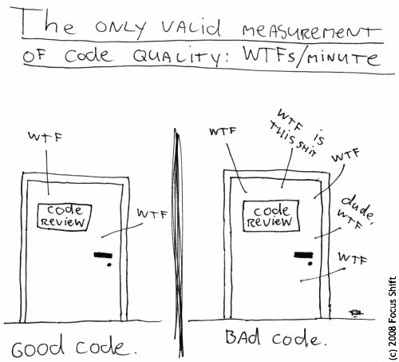
What are clean codes?

Slide 29
Why do we need clean code?
You’re a programmer
You want to be a better programmer
Your boss wants you to be a better programmer

Slide 30
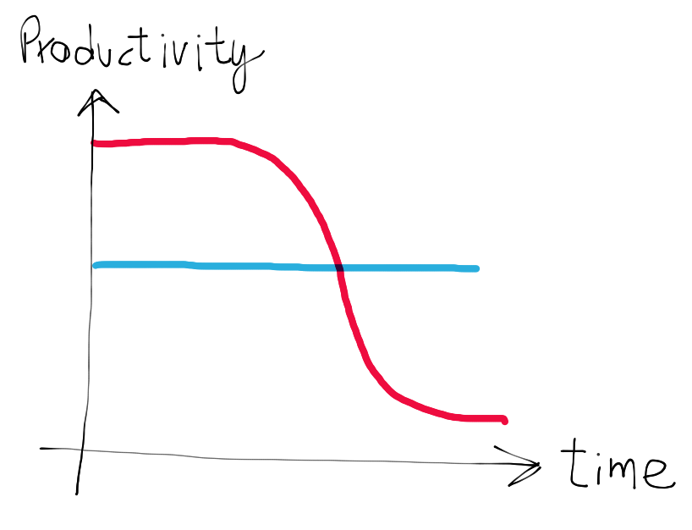
Really, why do we need clean code?
Change, modify, tweak, optimize
Reading time ~ 10 writing time!
Boy Scout Rule:
Leave the campground cleaner than you found it!
Notes:
We are constantly reading old code as part of the effort to write new code. Because this ratio is so high, we want the reading of code to be easy, even if it makes the writing harder. Of course there’s no way to write code without reading it, so making it easy to read actually makes it easier to write. There is no escape from this logic. You cannot write code if you cannot read the surrounding code. The code you are trying to write today will be hard or easy to write depending on how hard or easy the surrounding code is to read. So if you want to go fast, if you want to get done quickly, if you want your code to be easy to write, make it easy to read.

Slide 31
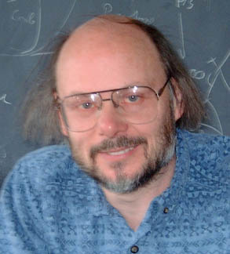
Definitions by experts
Bjarne Stroustrup (C++): I like my code to be elegant and efficient. The logic should be straightforward to make it hard for bugs to hide, the dependencies minimal to ease maintenance, error handling complete according to an articulated strategy, and performance close to optimal so as not to tempt people to make the code messy with unprincipled optimizations. Clean code does one thing well.
Notes:
Tempt: cám dỗ
Bjarne thinks that clean code is pleasing to read. Reading it should make you smile the way a well-crafted music box or well-designed car would. Bjarne also mentions efﬁciency—twice. Perhaps this should not surprise us coming from the inventor of C++; but I think there’s more to it than the sheer desire for speed.
Bad code tempts the mess to grow! When others change bad code, they tend to make it worse. Pragmatic Dave Thomas and Andy Hunt said this a different way. They used the metaphor of broken windows.3 A building with broken windows looks like nobody cares about it. So other people stop caring. They allow more windows to become broken. Eventually they actively break them. They despoil the facade with grafﬁti and allow garbage to collect. One broken window starts the process toward decay.

Slide 32
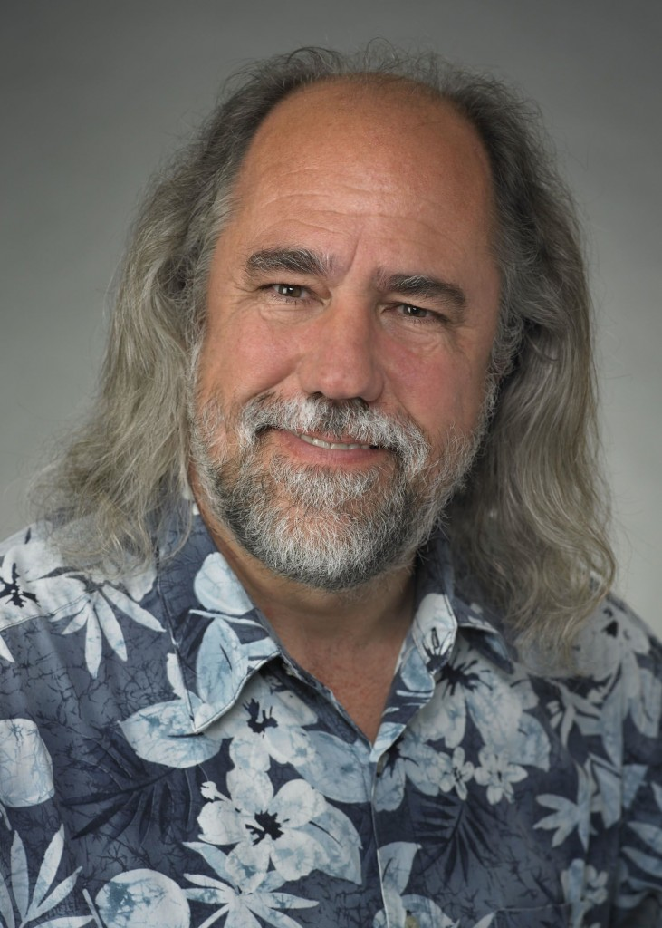
Definitions by experts
Grady Booch (UML): Clean code is simple and direct. Clean code reads like well-written prose. Clean code never obscures the designer’s intent but rather is full of crisp abstractions and straightforward lines of control.
Notes:
obscure: lu mờ
crisp: mạnh mẽ, quả quyết
I especially like his view that clean code should read like well-written prose. Think back on a really good book that you’ve read. Remember how the words disappeared to be replaced by images! It was like watching a movie, wasn’t it? Better! You saw the characters, you heard the sounds, you experienced the pathos and the humor.

Slide 33

Definitions by experts
Dave Thomas (Ruby): Clean code can be read, and enhanced by a developer other than its original author. It has unit and acceptance tests. It has meaningful names. It provides one way rather than many ways for doing one thing. It has minimal dependencies, which are explicitly defined, and provides a clear and minimal API. Code should be literate since depending on the language, not all necessary information can be expressed clearly in code alone.
Notes:
Dave ties cleanliness to tests! Ten years ago this would have raised a lot of eyebrows. But the discipline of Test Driven Development has made a profound impact upon our industry and has become one of our most fundamental disciplines. Dave is right. Code, without tests, is not clean. No matter how elegant it is, no matter how readable and accessible, if it hath not tests, it be unclean.
Dave uses the word minimal twice. Apparently he values code that is small, rather than code that is large. Indeed, this has been a common refrain throughout software literature since its inception. Smaller is better

Slide 34
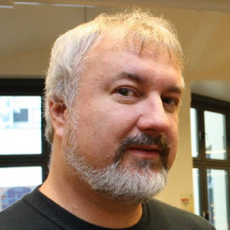

Definitions by experts
Michael Feathers (CppUnit): Clean code always looks like it was written by someone who cares
Ron Jeffries (XP): Reduced duplication, high expressiveness, and early building of simple abstractions
Notes:
After years of doing this work, it seems to me that all programs are made up of very similar elements. One example is “ﬁnd things in a collection.” Whether we have a database of employee records, or a hash map of keys and values, or an array of items of some kind, we often ﬁnd ourselves wanting a particular item from that collection. When I ﬁnd that happening, I will often wrap the particular implementation in a more abstract method or class. That gives me a couple of interesting advantages. I can implement the functionality now with something simple, say a hash map, but since now all the references to that search are covered by my little abstraction, I can change the implementation any time I want. I can go forward quickly while preserving my ability to change later. In addition, the collection abstraction often calls my attention to what’s “really” going on, and keeps me from running down the path of implementing arbitrary collection behavior when all I really need is a few fairly simple ways of ﬁnding what I want.

Slide 35
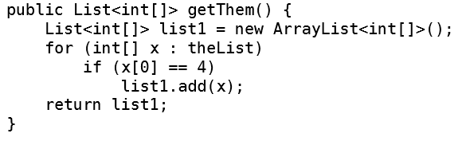
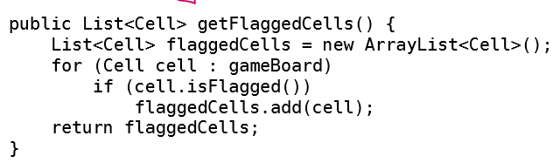
Meaningful name
Intention / revealing names

Slide 36
Meaningful name
No magic numbers!
switch (color)
{
case 1:
// do something
case 2:
// do something
case 3:
// do other thing
…
}
switch (color)
{
case RED:
// do something
case GREEN:
// do something
case BLUE:
// do other thing
…
}

Slide 37
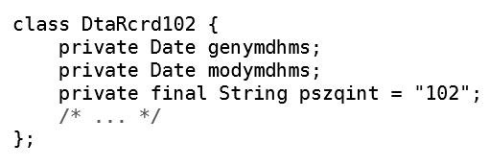
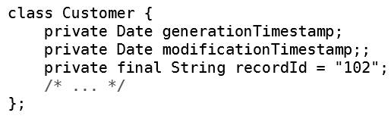
Meaningful name
Pronounceable names

Slide 38
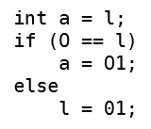
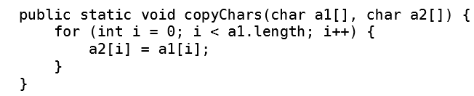

Meaningful name
Avoid disinformation
accountList vs accounts
listOfEmployeesIDDRMEncode vs listOfEmployeesIDRMEncode
0 or O, l or 1? ---- a1, a2?
Indistinguishable

Slide 39

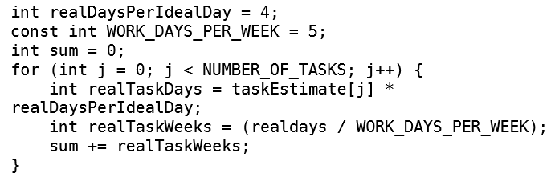
Meaningful name
Use searchable names

Slide 40
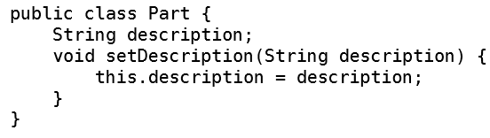
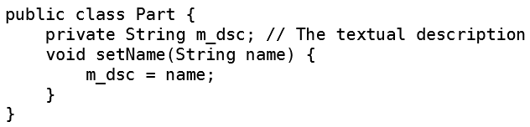
Meaningful name
Avoid encoding
Type in name: String strPhone or phone?
Boundary in name: private String mPhone or phone or _phone?
Interface: IShapeFactory or ShapeFactory?

Slide 41


Meaningful name
Avoid mental mapping
Nouns or verbs in names?
Nouns: class, attributes, variables
Verb: method, interface (sometimes)

Slide 42
Meaningful name
Pick one name per concept (or consistent name)
fetch, retrieve, get?
calculate, evaluate?
controller, manager, driver?
Don’t pick one name for two concepts
add, insert, append?

Slide 43
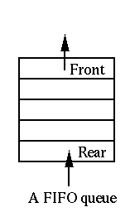
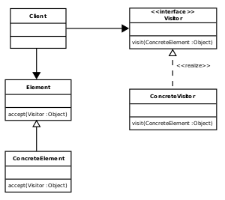
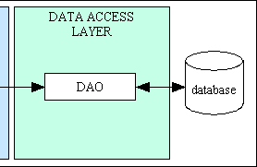
Meaningful name
Use Solution Domain Names
AccountVisitor UserDAO JobQueue

Slide 44
Meaningful name
Use Problem Domain Names
Accounting: totalAssests, ownerEquity, netIncome
Hospital:
IU_L or internationalUnitPerLiter?
mEq_L or milliEquivalentPerLiter?
Stock market:
DPS or dividendPerShare?
SD or specialDividend?

Slide 45
Meaningful name
Meaningful context
firstName, lastName, street, city, state, zipCode
addrFirstName, addrLastName, addrStreet, addrCity, …
class Address
firstName
lastName
street
…
But avoid gratuitous context
MACAddress or MAC?
WebAddress or URI?
Notes:
Gratuitous = thừa

